Slide 1
Neural Networks part 2
Jurafsky and Martin Chapters 7 and 9

Slide 2
Reminders
Homework 5 is due Tonight by 11:50pm
HW6 (NN-LM) has been released
Quizzes don’t have late days

Slide 3
Neural Network LMs part 2
Read ChapterS 7 and 9 in Jurafsky and Martin
Read Chapter 4 and 14 from Yoav Goldberg’s book Neural Networks Methods for NLP

Slide 4
Recap: Neural Networks
The building block of a neural network is a single computational unit. A unit takes a set of real valued numbers as input, performs some computation.

Slide 5
Recap: Feed-Forward NN
The simplest kind of NN is the Feed-Forward Neural Network
Multilayer network, all units are usually fully-connected, and no cycles.
The outputs from each layer are passed to units in the next higher layer, and no outputs are passed back to lower layers.
Layer 2 (output layer)
Layer 1 (hidden layer)
Layer 0 (input layer)
Notes:
We’ll introduce networks with cycles, called recurrent neural networks Later. For historical reasons multilayer networks, especially feedforward networks, are sometimes called multi-layer perceptrons (or MLPs); this is a technical misnomer, since the units in modern multilayer networks aren’t perceptrons (perceptrons are purely linear, but modern networks are made up of units with non-linearities like sigmoids), but at some point the name stuck.
The core of the neural network is the hidden layer formed of hidden units, each of which is a neural unit, taking a weighted sum of its inputs and then applying a non-linearity. In the standard architecture, each layer is fully-connected, meaning that each unit in each layer takes as input the outputs from all the units in the previous layer, and there is a link between every pair of units from two adjacent layers. Thus each hidden unit sums over all the input units.

Slide 6
Recap: Language Modeling
Goal: Learn a function that returns the joint probability
Primary difficulty:
There are too many parameters to accurately estimate.
In n-gram-based models we fail to generalize to related words / word sequences that we have observed.

Slide 7
Recap: Curse of dimensionality AKA sparse statistics
Suppose we want a joint distribution over 10 words. Suppose we have a vocabulary of size 100,000.
100,000¹⁰ =10⁵⁰ parameters
This is too high to estimate from data.

Slide 8
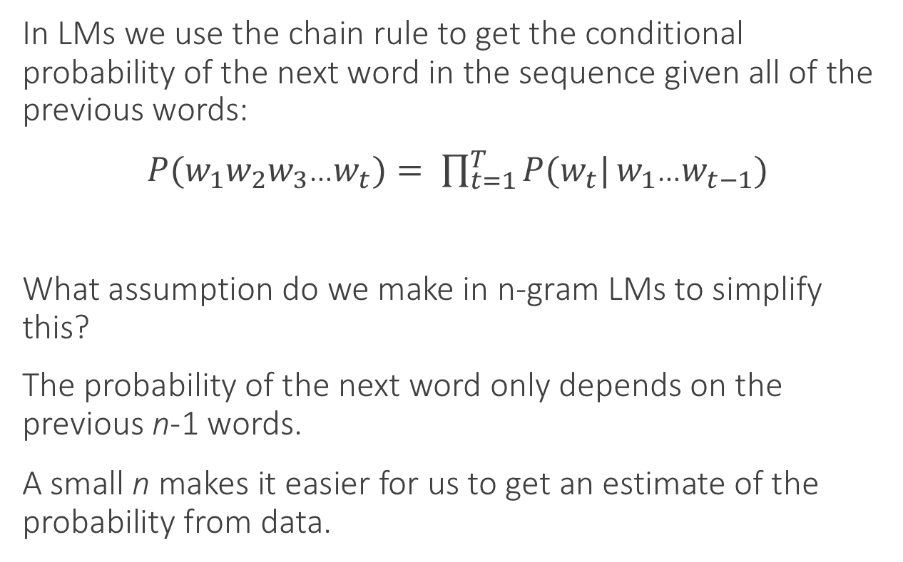
Recap: Chain rule
In LMs we use the chain rule to get the conditional probability of the next word in the sequence given all of the previous words:
$P(w_{1}w_{2}w_{3}$…$w_{t})= \prod_{t=1}^{T}{P(w_{t}|}w_{1}$…$w_{t−1})$
What assumption do we make in n-gram LMs to simplify this?
The probability of the next word only depends on the previous n-1 words.
A small n makes it easier for us to get an estimate of the probability from data.

Slide 9
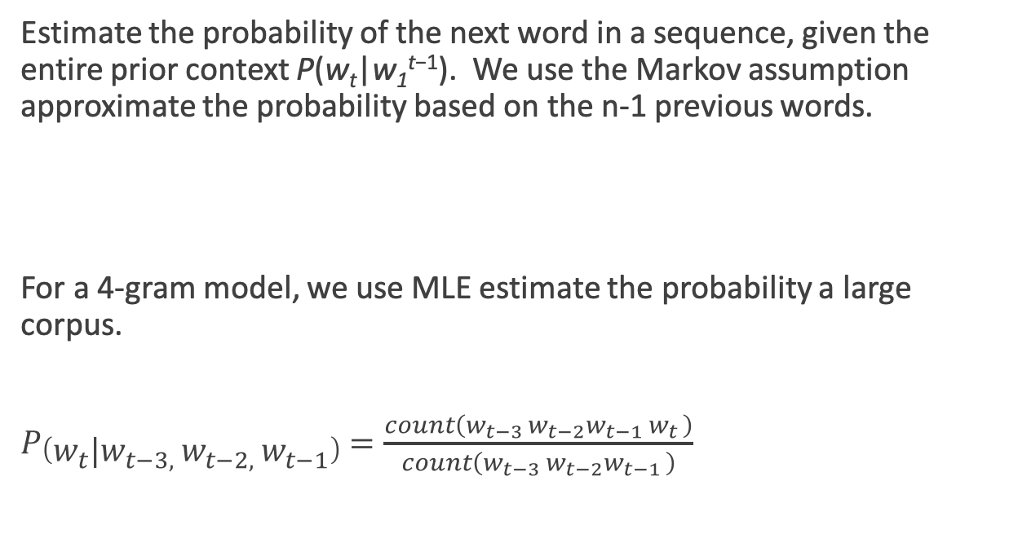
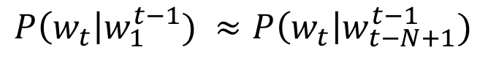
Recap: N-gram LMs
Estimate the probability of the next word in a sequence, given the entire prior context P(w_{t}|w₁^{t−1}). We use the Markov assumption approximate the probability based on the n-1 previous words.
For a 4-gram model, we use MLE estimate the probability a large corpus.
$P\left(w_{t}|w_{t−3, }w_{t−2, }w_{t−1}\right)=\frac{count\left(w_{t−3 }w_{t−2}w_{t−1 }w_{t }\right)}{count\left(w_{t−3 }w_{t−2}w_{t−1 }\right)}$
$$P\left(w_{t}\right|w_{1}^{t−1}) ≈P\left(w_{t}\right|w_{t−N+1}^{t−1})$$

Slide 10
Probability tables
We construct tables to look up the probability of seeing a word given a history.
The tables only store observed sequences.
What happens when we have a new (unseen) combination of n words?
curse of | P(w_{t} | w_{t-n} … w_{t-1})
dimensionality
azure
knowledge
oak
Notes:
“Stupid” multinomial distributions == table lookup.

Slide 11
Unseen sequences
What happens when we have a new (unseen) combination of n words?
Back-off
Smoothing / interpolation
We are basically just stitching together short sequences of observed words.

Slide 12
Alternate idea
Let’s try generalizing.
Intuition: Take a sentence like
The cat is walking in the bedroom
And use it when we assign probabilities to similar sentences like
The dog is running around the room
Notes:
Draw vectors under the words.
Write out: sim(cat, dog)

Slide 13
Similarity of words / contexts
Use word embeddings!
How can we use embeddings to estimate language model probabilities?
sim ( cat , dog )
Vector for cat
Vector for dog
p( cat | please feed the )
Concatenate these 3 vectors together, use that as input vector to a feed forward neural network
Compute the probability of all words in the vocabulary with a softmax on the output layer

Slide 14
Neural network with embeddings as input
W_{t-1})
Notes:
a feedforward neural language model moving through a text. At each timestep t the network takes the 3 context words, converts each to a d-dimensional embedding, and concatenates the 3 embeddings together to get the 1×Nd unit input layer x for the network. These units are multiplied by a weight matrix W and bias vector b and then an activation function to produce a hidden layer h, which is then multiplied by another weight matrix U. (For graphic simplicity we don’t show b in this and future pictures.)

Slide 15
A Neural Probabilistic LM
In NIPS 2003, Yoshua Begio and his colleagues introduced a neural probabilistic language model
They used a vector space model where the words are vectors with real values ℝ^{m}. m=30, 60, 100. This gave a way to compute word similarity.
They defined a function that returns a joint probability of words in a sequence based on a sequence of these vectors.
Their model simultaneously learned the word representations and the probability function from data.
Seeing one of the cat/dog sentences allows them to increase the probability for that sentence and its combinatorial # of “neighbor” sentences in vector space.

Slide 16
A Neural Probabilistic LM
Given:
A training set w₁ … w_{t} where w_{t} ∈V
Learn:
f(w₁ … w_{t}) = P(w_{t}|w₁ … w_{t-1})
Subject to giving a high probability to an unseen text/dev set (e.g. minimizing the perplexity)
Constraint:
Create a proper probability distribution (e.g. sums to 1) so that we can take the product of conditional probabilities to get the joint probability of a sentence

Slide 17
Neural net that learns embeddings
W_{t-1})
Notes:
a feedforward neural language model moving through a text. At each timestep t the network takes the 3 context words, converts each to a d-dimensional embedding, and concatenates the 3 embeddings together to get the 1×Nd unit input layer x for the network. These units are multiplied by a weight matrix W and bias vector b and then an activation function to produce a hidden layer h, which is then multiplied by another weight matrix U. (For graphic simplicity we don’t show b in this and future pictures.)

Slide 18
One-hot vectors
To learn the embeddings, we added an extra layer to the network. Instead of pre-trained embeddings as the input layer, we instead use one-hot vectors.
These are then used to look up a row vector in the embedding matrix E, which is of size d by |V|.
With this small change, we now can learn the emebddings of words.
Notes:
A one-hot vector is a vector that has one element equal to 1—in the dimension corresponding to that word’s index in the vocabulary— while all the other elements are set to zero.
Thus in a one-hot representation for the word “toothpaste”, supposing it happens to have index 5 in the vocabulary, x5 is one and and xi = 0 ∀i ̸= 5, as shown here:
Note that we don’t want to learn separate weight matrices for mapping each of the 3 previous words to the projection layer, we want one single embedding dictionary E that’s shared among these three. That’s because over time, many different words will appear as wt−2 or wt−1, and we’d like to just represent each word with one vector, whichever context position it appears in. The embedding weight matrix E thus has

Slide 19
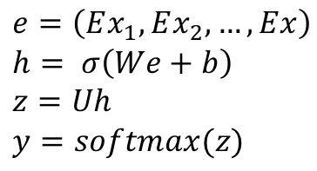
Forward pass
1. Select embeddings from E for the three context words (the ground there) and concatenate them together
2. Multiply by W and add b (not shown), and pass it through an activation function (sigmoid, ReLU, etc) to get the hidden layer h.
3. Multiply by U (the weight matrix for the hidden layer) to get the output layer, which is of size 1 by |V|.
4. Apply softmax to get the probability. Each node i in the output layer estimates the probability P(w_{t} = i|w_{t−1},w_{t−2},w_{t−3})
$$e=\left(Ex_{1},Ex_{2},…,Ex\right) \\ h= σ\left(We+b\right) \\ z=Uh \\ y=softmax(z)$$

Slide 20
Training with backpropagation
To train the models we need to find good settings for all of the parameters θ = E,W,U,b.
How do we do it? Gradient descent using error backpropagation on the computation graph to compute the gradient. Since the final prediction depends on many intermediate layers, and since each layer has its own weights, we need to know how much to update each layer.
Error backpropagation allows us to assign proportional blame (compute the error term) back to the previous hidden layers.
For information about backpropogation,
check out Chapter 5 of this book →

Slide 21
Training data
The training examples are simply word k-grams from the corpus
The identities of the first k-1 words are used as features, and the last word is used as the target label for the classification.
Conceptually, the model is trained using cross-entropy loss.
Notes:
Large output spaces Working with neural probabilistic language models with large output spaces (i.e., efficiently computing the softmax over the vocabulary) can be prohibitive both at training time and at test time. Dealing with large output spaces efficiently is an active research question. Some of the existing solutions are as follows.
Hierarchical softmax [Morin and Bengio, 2005] allows to compute the probability of a single word in O.log jV j/ time rather than O.jV j/. is is achieved by structuring the softmax computation as tree traversal, and the probability of each word as the product of branch selection decisions. Assuming one is interested in the probability of a single word (rather than getting the distribution over all words) this approach provides clear benefits in both training and testing time. Self-normalizing aproaches, such as noise-contrastive estimation (NCE) [Mnih and Teh, 2012, Vaswani et al., 2013] or adding normalizing term to the training objective [Devlin et al., 2014]. e NCE approach improves training time performance by replacing the cross-entropy objective with a collection of binary classification problems, requiring the evaluation of the assigned scores for k random words rather than the entire vocabulary. It also improves test-time prediction by pushing the model toward producing “approximately normalized” exponentiated scores, making the model score for a word a good substitute for its probability. e normalization term approach of Devlin et al. [2014] similarly improves test time efficiency by adding a term to the training objective that encourages the exponentiated model scores to sum to one, making the explicit summation at test time unnecessary (the approach does not improve training time efficiency). Sampling Approaches approximate the training-time softmax over a smaller subset of the vocabu- lary [Jean et al., 2015].
A good review and comparison of these and other techniques for dealing with large output vocabularies is available in Chen et al. [2016].
An orthogonal line of work is attempting to sidestep the problem by working at the char- acters level rather than words level.

Slide 22
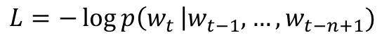
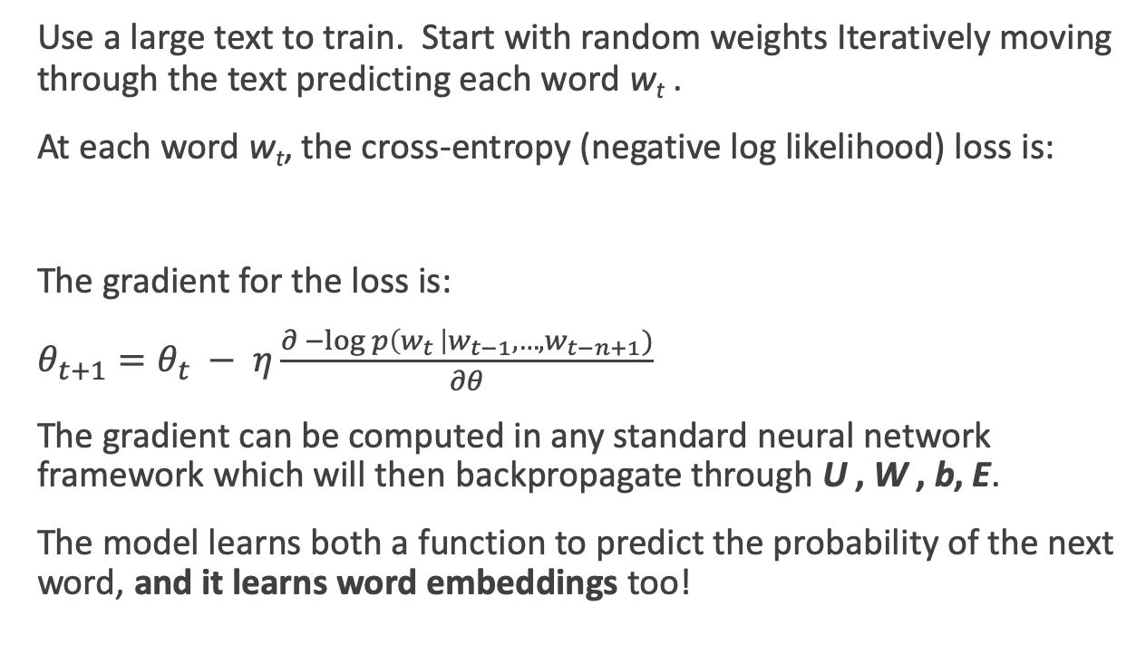
Training the Neural LM
Use a large text to train. Start with random weights Iteratively moving through the text predicting each word w_{t} .
At each word w_{t}, the cross-entropy (negative log likelihood) loss is:
The gradient for the loss is:
$θ_{t+1}=θ_{t} − η\frac{∂ −\log{p\left(w_{t }\right|w_{t−1}, …, w_{t−n+1})}}{∂θ}$
The gradient can be computed in any standard neural network framework which will then backpropagate through U , W , b, E.
The model learns both a function to predict the probability of the next word, and it learns word embeddings too!
$$L=−\log{p\left(w_{t }\right|w_{t−1}, …, w_{t−n+1})}$$

Slide 23
Learned embeddings
When the ~50 dimensional vectors that result from training a neural LM are projected down to 2-dimensions, we see a lot of words that are intuitively similar are close together.
Notes:
A by-product of training neural network-based language models are dense word embeddings, similar to word2vec.

Slide 24
Advantages of NN LMs
Better results. They achieve better perplexity scores than SOTA n-gram LMs.
Larger N. NN LMs can scale to much larger orders of n. This is achievable because parameters are associated only with individual words, and not with n-grams.
They generalize across contexts. For example, by observing that the words blue, green, red, black, etc. appear in similar contexts, the model will be able to assign a reasonable score to the green car even though it never observed in training, because it did observe blue car and red car.
A by-product of training are word embeddings!
Notes:
Language models can be trained on raw text: for training a k-order language model one just needs to extract .k C 1/grams from running text, and treat the .k C 1/th word as the supervision signal. us, we can generate practically unlimited training data for them.

Slide 25
Disadvantage of Feedforward Neural Networks
Bengio (2003) used a Feedfoward neural network for their language model. This means is that it operates only on fixed size inputs.
For sequences longer than that size, it slides a window over the input, and makes predictions as it goes.
The decision for one window has no impact on the later decisions.
This shares the weakness of Markov approaches, because it limits the context to the window size.
To fix this, we’re going to look at recurrent neural networks.

Slide 26
Current state of the art neural LMs
ELMo
GPT
BERT
GPT-2
Notes:
ELMo: Embeddings from Language Models
GPT: Improving Language Understanding by Generative PreTraining
BERT: Bidirectional Encoder Representations from Transformers.

Slide 27
Recurrent Neural Networks
Language is an inherently temporal phenomenon.
Logistic regression and Feedforward NNs are not temporal in nature. They use fixed size vectors that have simultaneous access to the full input all at once.
Work-arounds like a sliding window aren’t great, because
The decision made for one window has no impact on later decisions
It limits the context being used
Fails to capture important aspects of language like consistency and long distance dependencies
Notes:
When people are speaking, we don’t know how long their sentences will be. We are capable of processing continuous input streams of indefinite length.

Slide 28
Recurrent Neural Networks
A recurrent neural network (RNN) is any network that contains a cycle within its network.
In such networks the value of a unit can be dependent on earlier outputs as an input.
RNNs have proven extremely effective when applied to NLP.
Notes:
The hidden layer includes a recurrent connection as part of its input. That is, the activation value of the hidden layer depends on the current input as well as the activation value of the hidden layer from the previous time step.
The figure illustrates the structure of a simple RNN. As with ordinary feedforward networks, an input vector representing the current input element, xt , is multiplied by a weight matrix and then passed through an activation function to compute an activation value for a layer of hidden units. This hidden layer is, in turn, used to calculate a corresponding output, yt . In a departure from our earlier window-based approach, sequences are processed by presenting one element at a time to the network. The key difference from a feedforward network lies in the recurrent link shown in the figure with the dashed line. This link augments the input to the computation at the hidden layer with the activation value of the hidden layer from the preceding point in time.

Slide 29
Memory
We use a hidden layer from a preceding point in time to augment the input layer.
This hidden layer from the preceding point in time provides a form of memory or context.
This architecture does not impose a fixed-length limit on its prior context.
As a result, information can come from all the way back at the beginning of the input sequence. Thus we get away from the Markov assumption.

Slide 30
RNN as a feedforward network
Notes:
Forward inference (mapping a sequence of inputs to a sequence of outputs) in an RNN is nearly identical to what we’ve already seen with feedforward networks. To compute an output yt for an input xt, we need the activation value for the hidden layer ht . To calculate this, we multiply the input xt with the weight matrix W , and the hidden layer from the previous time step ht−1 with the weight matrix U. We add these values together and pass them through a suitable activation function, g, to arrive at the activation value for the current hidden layer, ht . Once we have the values for the hidden layer, we proceed with the usual computation to generate the output vector.

Slide 31
Forward inference
This allows us to have an output sequence equal in length to the input sequence.
Notes:
The process of mapping a sequence of inputs to a sequence of outputs is called forward inference.
Forward inference in a simple recurrent network. The matrices U , V and W are shared across time, while new values for h and y are calculated with each time step.

Slide 32
Unrolled RNN
time
Notes:
A simple recurrent neural network shown unrolled in time. Network layers are copied for each time step, while the weights U , V and W are shared in common across all time steps.
The fact that the computation at time t requires the value of the hidden layer from time t − 1 mandates an incremental inference algorithm that proceeds from the start of the sequence to the end. The sequential nature of simple recurrent networks can also be seen by unrolling the network in time as is shown here.

Slide 33
Training RNNs
Just like with feedforward networks, we’ll use a training set, a loss function, and back-propagation to get the gradients needed to adjust the weights in an RNN.
The weights we need to update are:
W – the weights from the input layer to the hidden layer U – the weights from the previous hidden layer to the current hidden layer V – the weights from the hidden layer to the output layer

Slide 34
Training RNNs
New considerations:
to compute the loss function for the output at time t we need the hidden layer from time t − 1.
The hidden layer at time t influences both the output at time t and the hidden layer at time t + 1 (and hence the output and loss at t+1)
To assess the error accruing to h_{t} , we’ll need to know its influence on both the current output as well as the ones that follow.

Slide 35
Backpropagation of errors
time
Notes:
The backpropagation of errors in a simple RNN ti vectors represent the targets for each element of the sequence from the training data. The red arrows illustrate the flow of backpropagated errors required to calculate the gradients for U , V and W at time 2. The two incoming arrows converging on h2 signal that these errors need to be summed.
Taken together, all of these considerations lead to a two-pass algorithm for train- ing the weights in RNNs. In the first pass, we perform forward inference, computing ht , yt , and accumulating the loss at each step in time, saving the value of the hidden layer at each step for use at the next time step. In the second phase, we process the sequence in reverse, computing the required error terms gradients as we go, comput- ing and saving the error term for use in the hidden layer for each step backward in time. This general approach is commonly referred to as Backpropagation Through Time

Slide 36
Vanishing/Exploding Gradients
In deep networks, it is common for the error gradients to either vanish or explode as they backpropagate. The problem is more severe in deeper networks, especially in RNNs.
Dealing with vanishing gradients is still an open research question. Solutions include:
making the networks shallower
step-wise training where first layers are trained and then fixed
performing batch-normalization
using specialized NN architectures like LSTM and GRU
Notes:
VANISHING AND EXPLODING GRADIENTS
In deep networks, it is common for the error gradients to either vanish (become exceedingly close
to 0) or explode (become exceedingly high) as they propagate back through the computation
graph. e problem becomes more severe in deeper networks, and especially so in recursive and
recurrent networks [Pascanu et al., 2012]. Dealing with the vanishing gradients problem is still
an open research question. Solutions include making the networks shallower, step-wise training
(first train the first layers based on some auxiliary output signal, then fix them and train the upper
layers of the complete network based on the real task signal), performing batch-normalization
[Ioffe and Szegedy, 2015] (for every minibatch, normalizing the inputs to each of the network
layers to have zero mean and unit variance) or using specialized architectures that are designed to
assist in gradient flow (e.g., the LSTM and GRU architectures for recurrent networks

Slide 37
Recurrent Neural Language Models
Unlike n-gram LMs and feedforward networks with sliding windows, RNN LMs don’t use a fixed size context window.
They predict the next word in a sequence by using the current word and the previous hidden state as input.
The hidden state embodies information about all of the preceding words all the way back to the beginning of the sequence.
Thus they can potentially take more context into account than n-gram LMs and NN LMs that use a sliding window.

Slide 38
Autoregressive generation with an RNN LM

Slide 39
Tag Sequences
Notes:
Part of speech tagging with a simple RNN

Slide 40
Sequence Classifiers
Notes:
Sequence classification using a simple RNN combined with a feedforward net- work. The final hidden state from the RNN is used as the input to a feedforward network that performs the classification.
Note that in this approach there are no intermediate outputs for the words in the sequence preceding the last element. Therefore, there are no loss terms associ- ated with those elements. Instead, the loss function used to train the weights in the network is based entirely on the final text classification task. Specifically, the out- put from the softmax output from the feedforward classifier together with a cross- entropy loss drives the training. The error signal from the classification is backprop- agated all the way through the weights in the feedforward classifier through, to its input, and then through to the three sets of weights in the RNN. This combination of a simple recurrent network with a feedforward classifier is our first example of a deep neural network. And the training regimen that uses the loss from a downstream application to adjust the weights all the way through the network is referred to as end-to-end training.

Slide 41
Stacked RNNs
Notes:
Stacked RNNs consist of multiple networks where the output of one layer serves as the input to a subsequent layer,
has been demonstrated across numerous tasks that stacked RNNs can outper- form single-layer networks. One reason for this success has to do with the network’s ability to induce representations at differing levels of abstraction across layers. Just as the early stages of the human visual system detect edges that are then used for finding larger regions and shapes, the initial layers of stacked networks can induce representations that serve as useful abstractions for further layers — representations that might prove difficult to induce in a single RNN.

Slide 42
Bidirectional RNNs

Slide 43
Bidirectional RNNs for sequence classification

Slide 44
Current state of the art neural LMs
ELMo
GPT
BERT
GPT-2
Notes:
ELMo: Embeddings from Language Models
GPT: Improving Language Understanding by Generative PreTraining
BERT: Bidirectional Encoder Representations from Transformers.

Slide 45
Summary
RNNs allow us to process sequences one element at a time.
RNNs can have one output per input. The output at a point in time is based on the current input and the hidden layer from the previous step.
RNNs can be trained similarly to feed forward NNs are using backpropagation through time.
Applications: LMs, generation, sequence labeling like POS tagging, sequence classification.
Next time: POS tagging!

